Slide 1
Simple Battleship
By: Simple Sam.

Slide 2
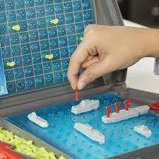
Overview
What is Battleship?
A strategy guessing game meant for two (2) players!
Origins tied to French Game L'Attaque
There are 4 grids in total, 2 for each player.
5 pieces for each player.
A player wins once all of their opponent's ships have sunk.
Goals
Designing & Implement the classic Battleship game.
Possibly implement the game to support over 2 players.

Slide 3

Project Design - Technical
Project is based around the client-server model.
The client-server model is an application architecture.
In this model there are clients & servers.
Header files
network_packet.h
Given struct for project.
Altered slightly.
grid.h
Defines the two grids seen in client.
Has key vital functions for gameplay.

Slide 4
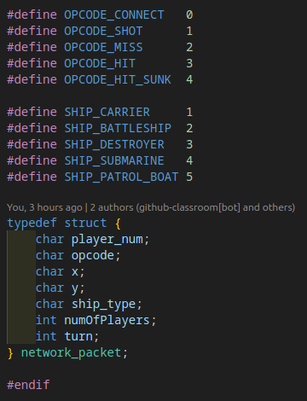
network_packet.h

Slide 5
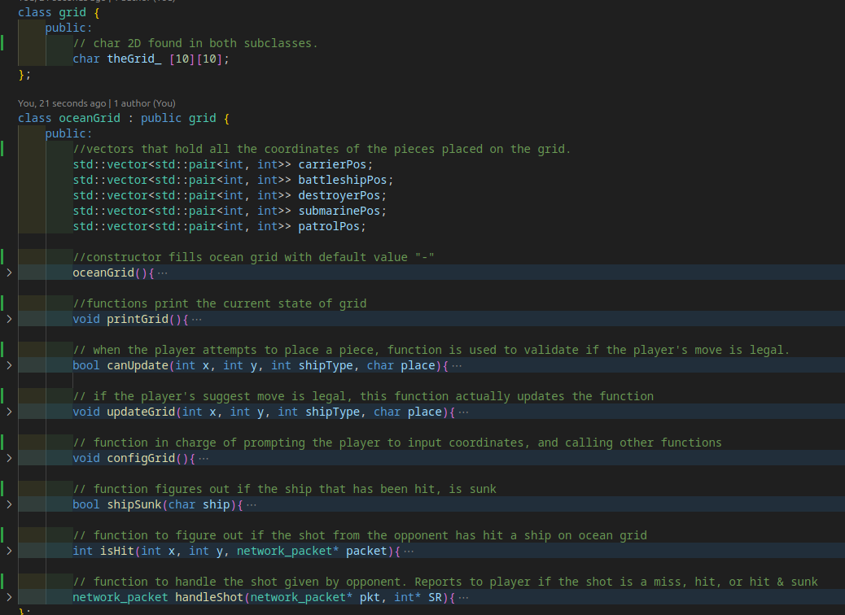
grid.h

Slide 6
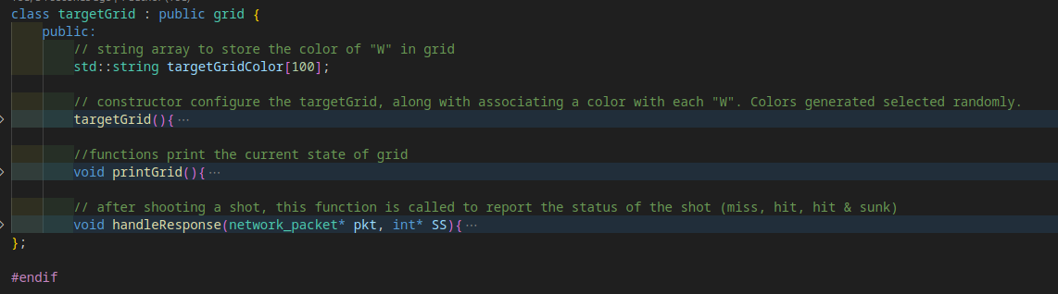
grid.h (continued)

Slide 7

Challenges/Triumph
Key Challenges:
Turn Management.
Tracking number of players.
Solutions:
Modification of the network_packet.
Slight modification of server.

Slide 8
Demo
https://youtu.be/K1HaNBaWYH0

Slide 9

Final Thoughts

